Slide 1
MS Access
Lab 26: Creating Database

Slide 2


Welcome to MS Access Class

Slide 3


What is Database?
An organized collection of data.
More specifically, a database is an electronic system that allows data to be easily accessed, manipulated.

Slide 4
Database
Create Database from template

Slide 5
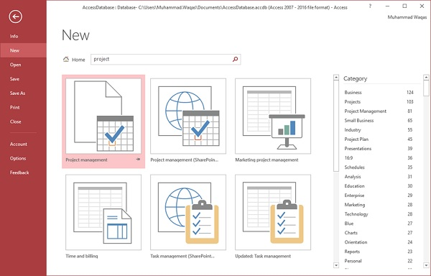
Create Database from Template
Let us enter project in the search box and press Enter. You will see the database templates related to project management.

Slide 6
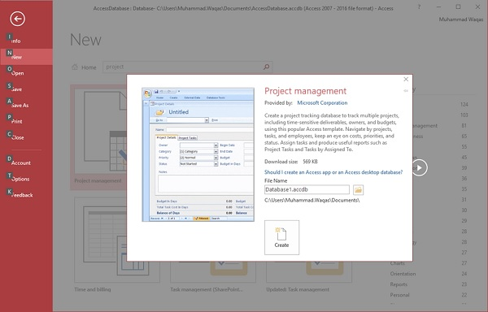
Create Database from Template
1. Select the first template. You will see more information
related to this template.

Slide 7
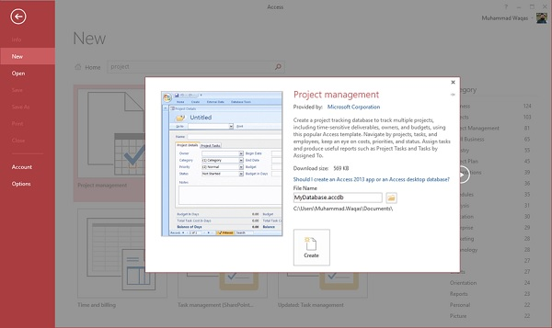
Create Database from Template
2. After selecting a template related to your requirements, enter a name in the File name field and you can also specify another location for your file if you want.

Slide 8
Create Database from Template
3. Press the Create option. Access will download that database template and open a new blank database as shown in the following screenshot

Slide 9
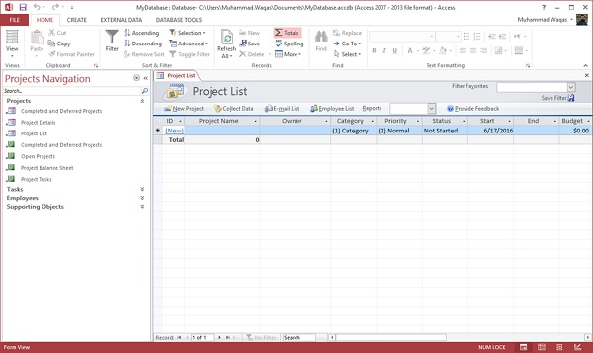
Create Database from Template
4. Click the Navigation pane on the left side and you will see all the other objects that come with this database.

Slide 10
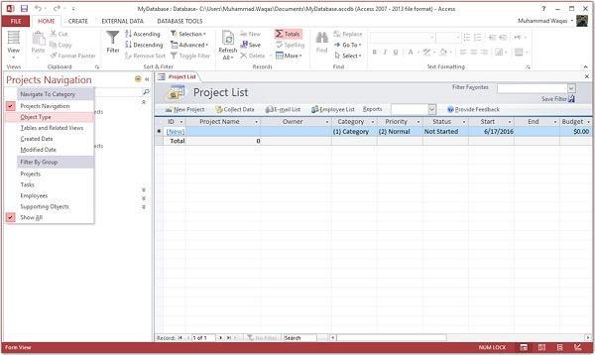
Create Database from Template
5. Click the Projects Navigation and select the Object Type in the menu

Slide 11
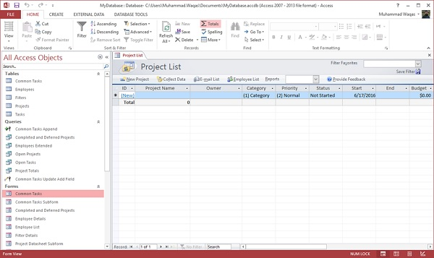
Create Database from Template
6. You will now see all the objects types — tables, queries, etc

Slide 12
MS Access-Database
Create Blank Database

Slide 13
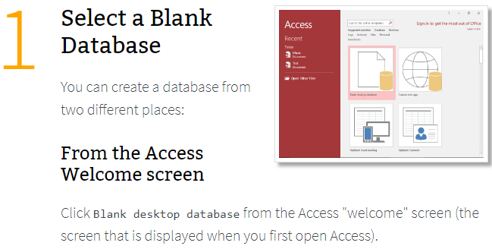
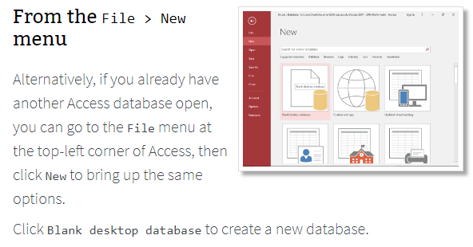
Create Blank Database

Slide 14
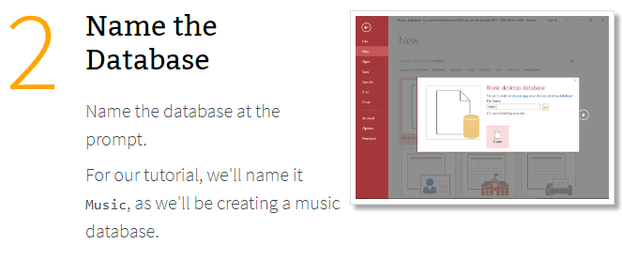
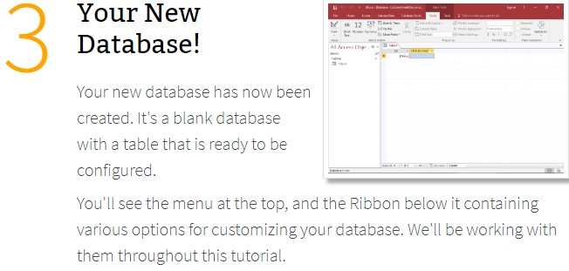
Create Blank Database

Slide 15

Thank You!

